Slide 1
Lec 05: Basics of Economics within the Context of Science, Technology, and Engineering
EEE 452: Engineering Economics and Management
M. Rokonuzzaman, PhD
Zaman.rokon.bd@gmail.com
www.the-waves.org
©️Rokonuzzaman
--use is permitted only for the purpose of EEE 452 (sections 1,2, 3, 4 & 10 offered at NSU in Spring 2023);no consumption and distribution is allowed for any other purpose

Slide 2
Definitions…
Science is about identifying variables and establishing quantitative (or at least, logically very strong) relations among them to interpret and scale up art. Technology is about intentional manipulation of those variables to invent or advance means for getting jobs done better.
Engineering is the use of scientific principles to design and build machines through optimum allocation of resources; cost-effective technology solution of an economic problem (how to make the best use of limited, or scarce resources).
Engineering economics, previously known as engineering economy, is a subset of economics concerned with the use and "...application of economic principles” in the analysis of engineering decisions—for exploiting unfolding technology possibilities in market economy.
It focuses on the decision making process, its context and environment. It is pragmatic by nature, integrating economic theory with engineering practice.

Slide 3
What is Economics?
How Science and Technology Affect It?
Science and Technology (S&T) affects economic value creation. In addition to increasing value, it also reduces value. For example, Electric vehicle is increasing the value of cobalt, while decreasing the demand for oil. S&T affects value, production, distribution, and consumption of goods and services. For example, e-book technology has transformed how we publish, distribute and consume contents of books.
S&T affects economic activities both at micro and macro level. For example, S&T powers price setting capability, creating imperfect market.
S&T has the capacity to affect employment, value of capital and natural resources, and the economic growth. Public policies play an important role in turning S&T in favor of job creation and growth.
Economics is the social science that studies how people interact with value; in particular, the production, distribution, and consumption of goods and services.
Economics focuses on the behaviour and interactions of economic agents and how economies work.
Microeconomics analyses basic elements in the economy, including individual agents and markets, their interactions, and the outcomes of interactions.
Individual agents may include, for example, households, firms, buyers, and sellers.
Macroeconomics analyses the economy as a system where production, consumption, saving, and investment interact, and factors affecting it: employment of the resources of labour, capital, and land, currency inflation, economic growth, and public policies that have impact on these elements.

Slide 4
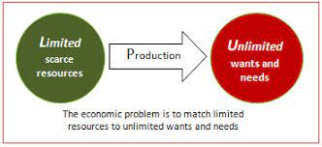
Scarcity and Unlimited Wants
Scarcity: the limited nature of society’s resources
Economics: the study of how society manages its scarce resources, e.g. how people decide what to buy, how much to work, save, and spend how firms decide how much to produce, how many workers to hire how society decides how to divide its resources between national defense, consumer goods, protecting the environment, and other needs
But the society has been facing growing demand for wealth to meet increasing consumption. Hence, optimum distribution of scarce resource is not good enough to face the reality of increasing quality of living standards to growing number of people with scarce resource.
Yes, we have scarcity in natural resources and labour. In the short-run, we cannot increase economic value creation from the same amount of labour and natural resources. But in the long run, S&T offers us means to extract increasingly more value from the same amount of other production factors. Hence, S&T has been a great help to produce increasing value from scarce resources to meet our growing consumption.
S&T has the potential to improve both products and production processes in deriving increasing economic value. However, it does not keep doing it linearly.
“If economic growth could be achieved only by doing more and more of the same kind of cooking, we would eventually run out of raw materials and suffer from unacceptable levels of pollution and nuisance. Human history teaches us, however, that economic growth springs from better recipes, not just from more cooking. New recipes generally produce fewer unpleasant side effects and generate more economic value per unit of raw material”—Paul Romer

Slide 5
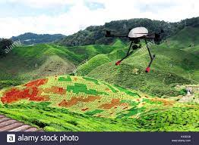
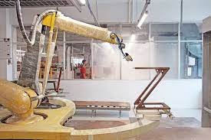
Principle #1: People Face Trade-offs
All decisions involve trade-offs. Examples: having more money to buy stuff requires working longer hours, which leaves less time for leisure. Protecting the environment requires resources that could otherwise be used to produce consumer goods.
Such reality compels firms making value-cost trade offs – either creating greater value for customers at a higher cost or creating reasonable value at a lower cost.
In the long-run, however, S&T keeps diminishing the necessity of making such trade-offs. For example, the use of robots in painting cars increases the quality of painting and reduces the cost simultaneously. This is due to the fact that robot painting work requires less rework. Furthermore, it also reduces wastage of paints. In fact, robots are being used in painting furniture in Bangladesh for improving the quality and reducing the cost.
Similarly, precision farming practice in using UAV for adaptively spraying pesticides and fertilizers offers the opportunity to get rid off quality-cost trade-off—increasing the quality and reducing the cost simultaneously.
Exploitation of this the capability of S&T has been changing competition strategy. As opposed to being provider of inferior quality products at lower cost, smarter producers are after offering higher quality at lower cost.
Furthermore, S&T has also been empowering individuals to extract more utility in less time and cost, resulting in decreasing need for making trade offs.

Slide 6
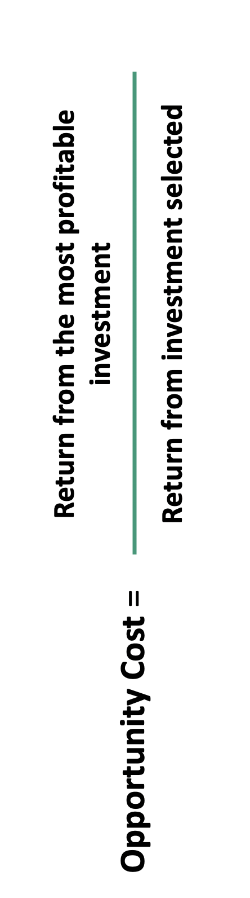
Principle #2: The Cost of Something Is What You Give Up to Get It
Decisions require comparing costs and benefits of alternatives.
Whether to go to college or to work?
Whether to go to class or sleep in?
Economic cost is the combination of losses of any goods that have a value attached to them by any one individual. Economic cost is used mainly by economists as means to compare the prudence of one course of action with that of another. The factors to be taken into consideration are money, time, and other resources; cost is the sum of explicit costs.
The opportunity cost of an item is what you give up to obtain that item. It is the relevant cost for decision making. Decision is not taken in favour of an investment until return from the investment selected is more than the return from the most profitable alternate investment opportunity.
Economic cost is very easy to estimate. In exploiting economic value, however, opportunity cost is extremely difficult to estimate. This is due to pervasive uncertainties sustaining over a prolonged period of time. In fact, lack of inaccuracy of estimating opportunity cost is one of the primary reasons behind the failure of incumbent firms to dive into self-destruction for recreation.

Slide 7
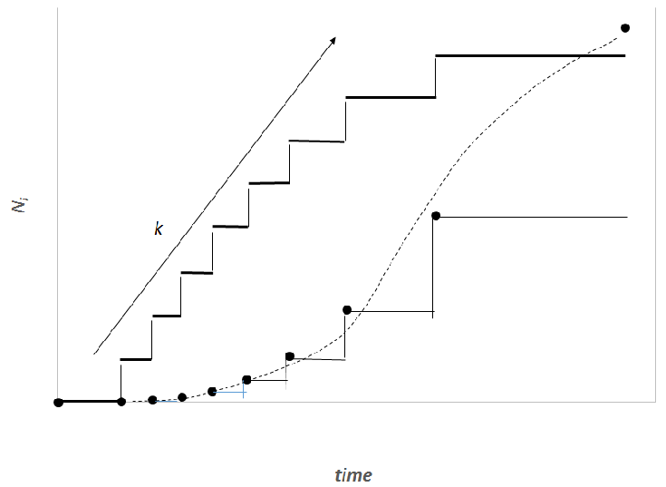
Principle #3: Rational People Think at the Margin
Marginal changes are small, incremental adjustments to an existing plan of action.
Systematically and purposefully do the best they can to achieve their objectives. They make decisions by evaluating costs and benefits of marginal changes – incremental adjustments to an existing plan.
This marginal cost-benefit analysis based thinking is extremely inappropriate for justifying the act in favour of loss making uncertain alternative by taking away resources from profit making incumbent opportunities.
For example, iPod was the life saviour for Apple—saving Apple from imminent bankruptcy. While both revenue and profit of iPod kept growing, Steve Jobs took a decision to kill iPod. Certainly, this decision was not justified by marginal cost-benefit analysis. In fact, thinking at the margin was suggesting otherwise—keep increasing resource for incremental advancement of iPod for extending the profit making life of this cash cow.
Steve Jobs went against the marginal cost-benefit analysis to counter the unfolding threat--invasion of smartphone in taking the business of iPod. Hence, Steve Jobs plunged into the dive of reinventing smartphone to kill iPod—far before someone else did. End result, we all know.
If Steve were guided by marginal cost-benefit analysis, Apple’s history could have been different. In fact, marginal cost-benefit analysis based decision making culture is highly detrimental to succeed at the the intersection between two waves of the episodic journey of rolling waves of invention. However, such a marginal-cost benefit analysis is quite useful during the metamorphosis phase—for creating the flywheel effect out of cumulative effect of incremental flow of ideas.
Thinking at the margin justifies this path
Natural tendency of failing to this decision of self-destruction for recreation

Slide 8
Principle #4: People Respond to Incentives
Economic incentives are what motivates you to behave in a certain way, while preferences are your needs, wants and desires. Economic incentives provide you the motivation to pursue your preferences.
For examples, customers are after higher quality product at less price. Producers are after more profit. On the other hand, input providers are after higher price, and the Government is asking for more taxes and less harm on the environment.
Human beings are driven by economic incentive.
Marginal changes in costs or benefits motivate people to respond.
The decision to choose one alternative over another occurs when that alternative’s marginal benefits exceed its marginal costs!
How can firms produce profit for investors by offering higher quality at less price for the customers and paying more to input providers?
Such a conflicting situation demands tradeoffs.
However, S&T offers the opportunity of addressing conflicting incentives simultaneously.
To create increasing value from same inputs, smart firms keep focusing on scaling up ideas out of science and technology for creating incentives for all—often, highly conflicting.
Success of creating incentives for all leads to price setting capability.

Slide 9
Principle #5: Trade Can Make Everyone Better Off
People gain from their ability to trade with one another.
Competition results in gains from trading.
Trade allows people to specialize in what they do best.
Rather than being self-sufficient, people can specialize in producing one good or service and exchange it for other goods. Countries also benefit from trade & specialization: Get a better price abroad for goods they produce and buy other goods more cheaply from abroad than could be produced at home.
S&T has been contributing to expand trade. For example, many less developed countries had chronic high unemployment among un-skilled workforce in the 1960s. The technology of dividing the factory work into small pieces, engineering process for performing each of those pieces in a certain sequency following some simple rules, and automating knowledge and skill intensive tasks has led to enabling low skilled workforce of less developed countries to add value in factory work. This technology has led to the globalization of manufacturing—expanding the global labor trade.
Similarly, technology progression has created the trade of petroleum, making many countries of the middle east prosperous.
However, technology progression has the tendency of reducing the trade of labor and natural resources. For example, automation has been negatively affecting market value of labour. But technology has a natural tendency of increasing both consumer and producer surpluses—thereby, expanding the trade. Furthermore, international trade has been showing price setting characteristics due to technology progression.
https://en.wikipedia.org/wiki/Paul_Krugman
Market value of labor and material
Technology

Slide 10
Principle #6: Markets Are Usually a Good Way to Organize Economic Activity
A market economy is an economy that allocates resources through the decentralized decisions of many firms and households as they interact in markets for goods and services.
Households decide what to buy and who to work for.
Firms decide who to hire and what to produce.
To leverage ideas for creating economic value, market economy adopted some favorable principles.
Ownership of capital and freedom of competition appear to be highly beneficial to foster wealth creation out of science and technology. Yes, market economy principles are in favor of intensifying competition to exploit profit making opportunity from technology ideas. The scalability of ideas, however, leads to price setting capability. Smart firm emerges with the capability of offering the highest quality at the lowest cost. This is the outcome of consistent exploitation of science in scaling up ideas. As a result, the competition force of market economy slows down. The competition, however, is vital to nurture ideas through a flow of incremental ideas.
Adam Smith made the observation that households and firms interacting in markets act as if guided by an “invisible hand.”
Despite the fact that economic value creation out of S&T benefits from profit making competition in nurturing ideas, progression of S&T has a natural tendency of weakening competition, and empowering the accumulation of market power.

Slide 11
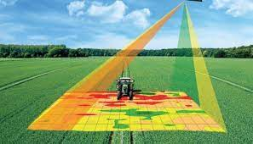
Principle #7: Governments Can Sometimes Improve Market Outcomes
Market failure occurs when the market fails to allocate resources efficiently. When the market fails (breaks down) government can intervene to promote efficiency and equity.
Market failure may be caused by
an externality, which is the impact of one person or firm’s actions on the well-being of a bystander.
market power, which is the ability of a single person or firm to unduly influence market prices.
Particularly, technology innovation market suffers from market failure. The necessity of a long journey in creating profitable willingness to pay discourage private investment. Furthermore, such a journey is fraught with pervasive uncertainties. On top of it, overall economic policies affect both the supply and demand creation of economic value creation out of local production of technology innovations. Hence, there has been prevailing market failure in unlocking technology possibilities—particularly in less developed countries. Therefore, the Government has a strong role to prime the innovation pump.
For example, there is a possibility of reducing farming inputs by harnessing the potential of precision farming. But in the absence of it, farmers remain deprived from getting benefit from the possibility. On the other hand, growing number of science and engineering graduates have been failing to get quality jobs for developing and deploying technology ideas. This is a typical example of market failure in exploiting prevailing possibilities.
Government can address precision farming market failure by investing in R&D, and giving incentives for adopting innovation for reducing farming input wastage.

Slide 12
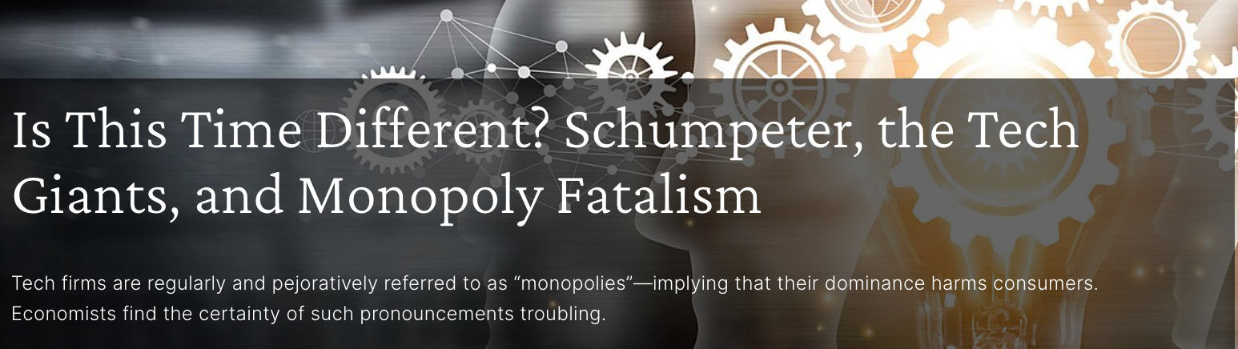
Externalities: Technologies create both negative and positive externalities.
Technology innovation creates externality effects. For example, emission from vehicles or radiation from cellphone towers affect the health of citizens. It’s beyond the capacity of an individual citizen to reduce such negative externality effects. Hence, there has been a role for the Government—through policies and regulation.
On the other hand, some technology decisions create positive externality effect. For example, the adoption of standards and the facilitation of infrastructure roll out create positive externality effects. For example, stimulation of charging station infrastructure in compliance with common standards will have positive externality effect on environment.
Market Power: By exploiting the technology possibilities, smart firms can attain price setting capability—known as market power. Differentiation, and economies of scale, scope and network externality effects are among common factors for attaining market power. On the other hand, through outperforming competitors in offering higher quality at lower cost by taking the advantage of technology possibilities, smart providers can gain market power even in homogeneous products. But should the government prevent it, as it’s anti-competitive. It depends. It’s not always a good intervention to prevent the accumulation of market power out of technology possibilities. In many cases, it’s highly beneficial for the customers. It’s worth noting that technology possibilities have natural tendency of monopoly—and the challenge is how to harness it without giving up to monopoly
Well, how to restore competition. As opposed to clipping the wings of a smart performer, Government should intervene to fuel the growth of the next wave of reinvention. Lesson should be drawn from the disappearance of market power of Nokia or Microsoft’s Internet browser.
https://www.cato.org/publications/policy-analysis/time-different-schumpeter-tech-giants-monopoly-fatalism

Slide 13
Principle #8: A country's standard of living depends on its ability to produce goods and services The Standard of Living Depends on a Country’s Production & Better Ideas
Standard of living may be measured in different ways:
By comparing personal incomes.
By comparing the total market value of a nation’s production.
Almost all variations in living standards are explained by differences in countries’ productivities.
Productivity is the amount of goods and services produced from each hour of a worker’s time.
At the end of the day, standard of living largely depends on how much utility someone derives in getting jobs done over certain period of time –say a day, week, month or year. This utility extraction depends of the quality and cost of products, and how they are deployed in getting numerous jobs done.
Technology possibilities are at the root in increasing the equality and reducing cost. Due to its power of increasing both consumer and producer surpluses by opening the door of offering higher quality at lower cost, technology has been playing a vital role in increasing our quality of living standards.
As we know, economic value creation, Y=F(natural resource, labor, ideas), by focusing on technology ideas, economic actors can keep expanding the supply of economic value—leading to growing consumption. Hence, harnessing technology possibilities is at the center of addressing our quality of living standards.

Slide 14
Principle #9: Prices Rise When the Government Prints Too Much Money
In economics, inflation is a general rise in the price level of an economy over a period of time. When the general price level rises, each unit of currency buys fewer goods and services
One cause of inflation is the growth in the quantity of money.
When the government creates large quantities of money, the value of the money falls—as it outstrips the growth of economic value creation.
Hence, Government should focus on additional wealth creation for creating scope of printing money without causing inflation.
Y =F(K,L ,A)
As we know, the growth of economic value creation faces the limit set by the scarcity of natural resources and labor. But technology ideas offer us endless frontier of wealth creation. But to tap into it, Government should take a series of measures, including addressing market failure, for opening and expanding the door of creating economic value out of production and trading of technology ideas.

Slide 15
Principle #10: Society Faces a Short-run Tradeoff Between Inflation and Unemployment
Society faces a short-run trade-off between unemployment and inflation. If policymakers expand aggregate demand, they can lower unemployment, but only at the cost of higher inflation. If they contract aggregate demand, they can lower inflation, but at the cost of temporarily higher unemployment.
But can technology change this apparent law—particularly, in the long-run? Yes, it can. It can increase demand and employment and lower inflation simultaneously. Technology has the possibility of increasing the demand and supply by improving quality and lowering the cost of production. It has the possibility of lowering inflation and increasing employment too. By increasing the value creation from each unit of labour and human capital, technology possibility can increase both the economic value, employment and demand. Hence, in the long run, technology can help the society to avoid trade-off between unemployment and inflation

